Slide 1

Lab-3 V.Sai Srikar (Se20UARI164)

Slide 2
Histogram Calculation and plot line
import cv2
from matplotlib import pyplot as plt
img = cv2.imread('lab3/nightsky.png')
plt.hist(img.ravel(),256,[0,256])
plt.show()
color = ('b','g','r')
for i,col in enumerate(color):
histr = cv2.calcHist([img],[i],None,[256],[0,256])
plt.plot(histr,color = col)
plt.xlim([0,256])
plt.show()

Slide 3
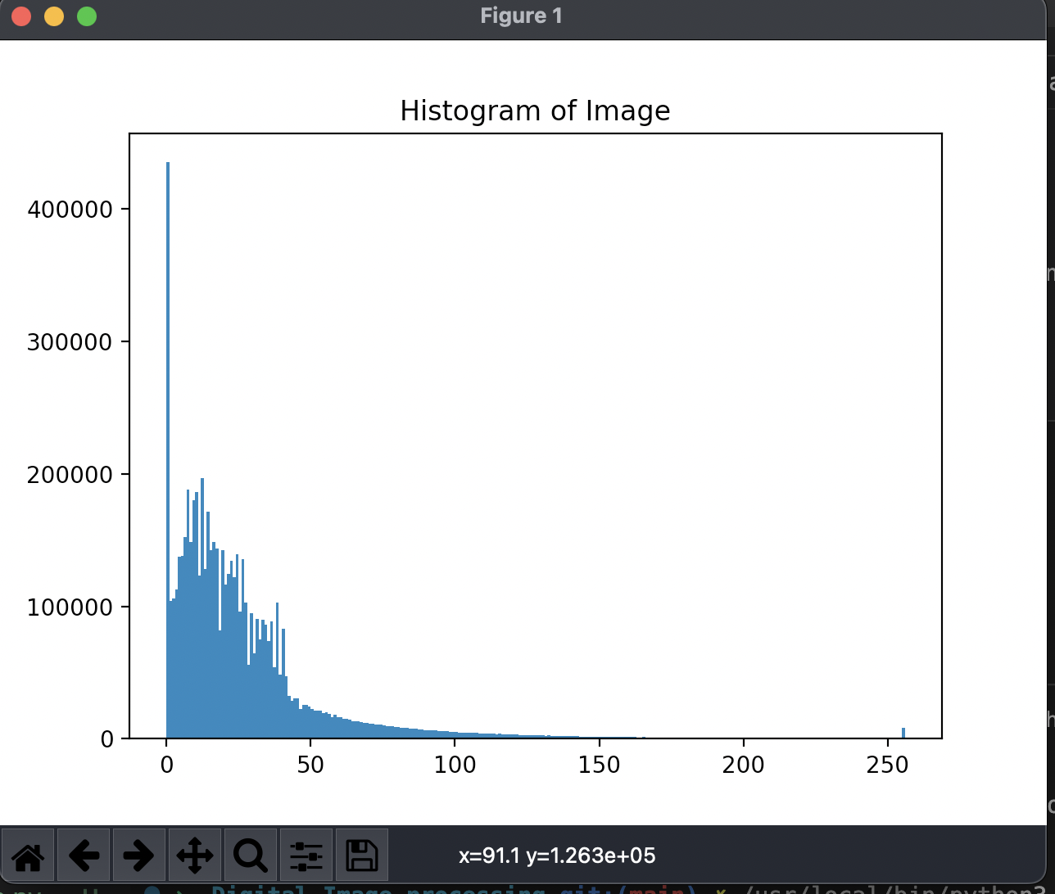
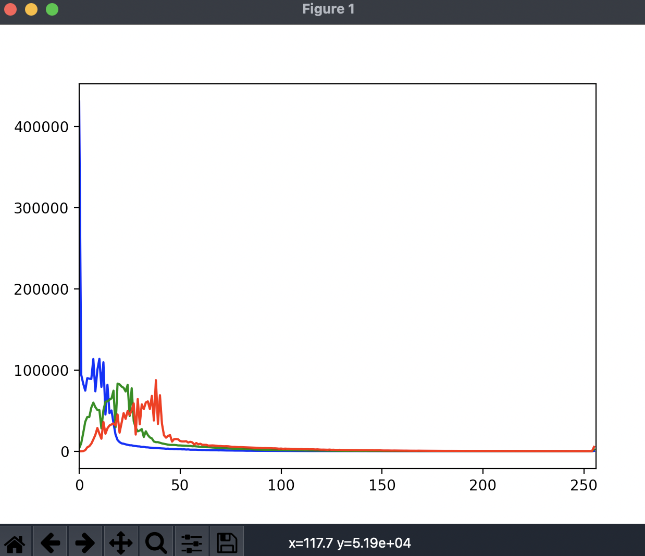
OUTPUT-:

Slide 4
Histogram with and without mask
import cv2
from matplotlib import pyplot as plt
import numpy as np
img = cv2.imread("lab3/nightsky.png",0)
# create a mask
mask = np.zeros(img.shape[:2], np.uint8)
mask[100:300, 100:400] = 255
masked_img = cv2.bitwise_and(img,img,mask = mask)
hist_full = cv2.calcHist([img],[0],None,[256],[0,256])
hist_mask = cv2.calcHist([img],[0],mask,[256],[0,256])
plt.subplot(221), plt.imshow(img, "gray")
plt.subplot(222), plt.imshow(mask,"gray")
plt.subplot(223), plt.imshow(masked_img, "gray")
plt.subplot(224), plt.plot(hist_full), plt.plot(hist_mask)
plt.xlim([0,256])
plt.show()

Slide 5
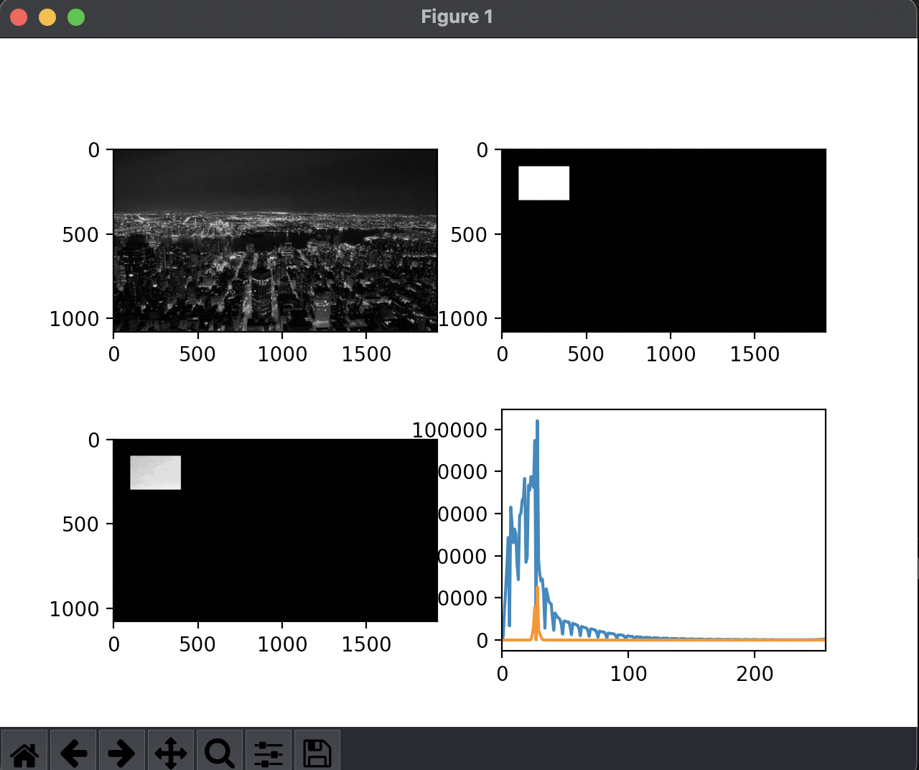
OUTPUT-:

Slide 6
Histogram EQUALIZATION
import numpy as np
import cv2 as cv
from matplotlib import pyplot as plt
img = cv.imread('lab3/nightsky.png',0)
hist,bins = np.histogram(img.flatten(),256,[0,256])
cdf = hist.cumsum()
cdf_normalized = cdf * float(hist.max()) / cdf.max()
plt.plot(cdf_normalized, color = 'b')
plt.hist(img.flatten(),256,[0,256], color = 'r')
plt.xlim([0,256])
plt.legend(('cdf','histogram'), loc = 'upper left')
plt.show()
cdf_m = np.ma.masked_equal(cdf,0)
cdf_m = (cdf_m - cdf_m.min())*255/(cdf_m.max()-cdf_m.min())
cdf = np.ma.filled(cdf_m,0).astype('uint8')
img2 = cdf[img]
cv.imshow("histogram equalization",img2)
cv.waitKey(0)
cv.destroyAllWindows()
plt.plot(cdf_m, color = 'b')
plt.hist(img2.flatten(),256,[0,256], color = 'r')
plt.xlim([0,256])
plt.legend(('cdf','histogram'), loc = 'upper left')
plt.show()

Slide 7
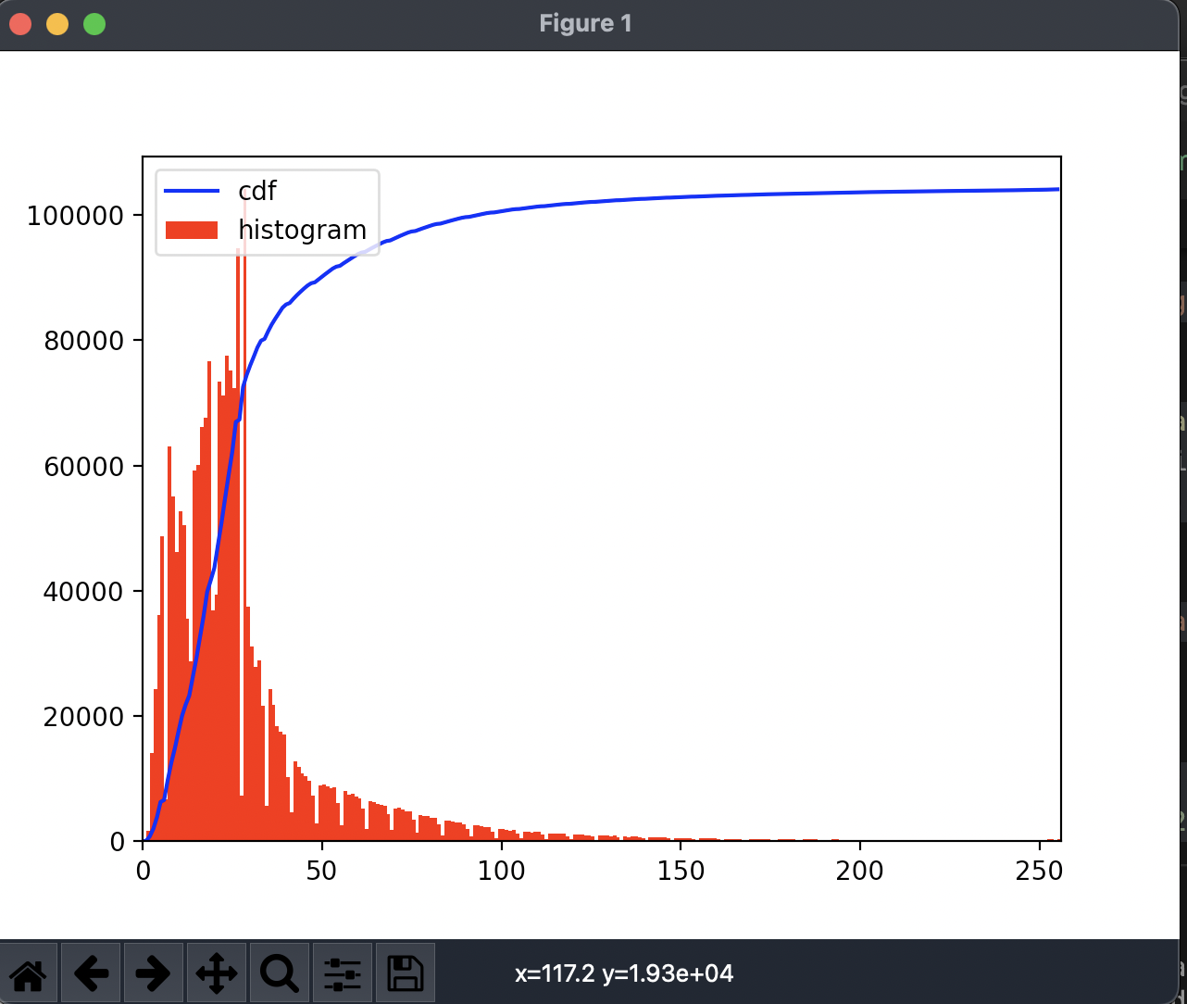
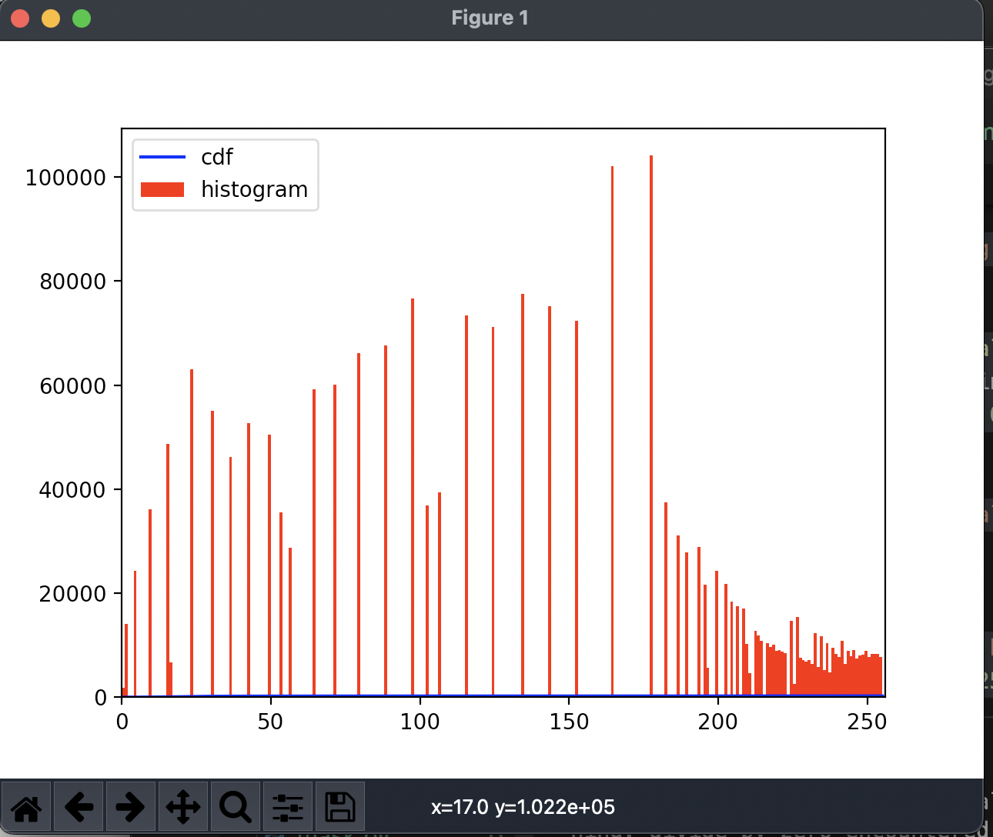
OUTPUT-:
THE RANGE OF THE HISTOGRAM IS INCREASED

Slide 8
Arithmetic operations
import cv2
import numpy as np
img1=cv2.imread("lab3/banana.png")
img2=cv2.imread("lab3/apple.png")
#can only add images of same size
N_img1=cv2.resize(img1,(500,500))
N_img2=cv2.resize(img2,(500,500))
img_sum=cv2.add(N_img1,N_img2)
img_subtract=cv2.subtract(N_img1,N_img2)
img_mul=cv2.multiply(N_img1,N_img2)
img_div=cv2.divide(N_img1,N_img2)
cv2.imshow('Addition',img_sum)
cv2.waitKey(0)
cv2.destroyAllWindows()
cv2.imshow('Subtraction',img_subtract)
cv2.waitKey(0)
cv2.destroyAllWindows()
cv2.imshow('Multiplication',img_mul)
cv2.waitKey(0)
cv2.destroyAllWindows()
cv2.imshow('Divison',img_div)
cv2.waitKey(0)
cv2.destroyAllWindows()

Slide 9
Arithmetic operations
#numpy implementation
added_img=N_img1+N_img2
sub_img=N_img1-N_img2
mul_img=N_img1*N_img2
div_img=N_img1/N_img2
cv2.imshow('Addition',added_img)
cv2.waitKey(0)
cv2.destroyAllWindows()
cv2.imshow('Subtraction',sub_img)
cv2.waitKey(0)
cv2.destroyAllWindows()
cv2.imshow('Multiplication',mul_img)
cv2.waitKey(0)
cv2.destroyAllWindows()
cv2.imshow('Divison',div_img)
cv2.waitKey(0)
cv2.destroyAllWindows()

Slide 10
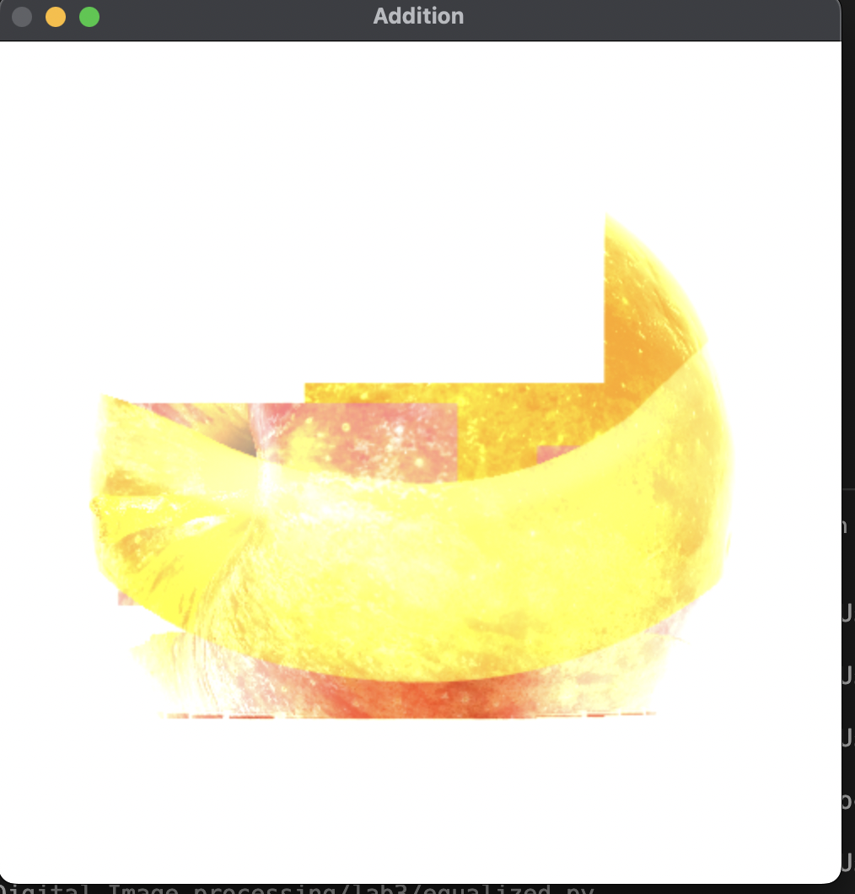
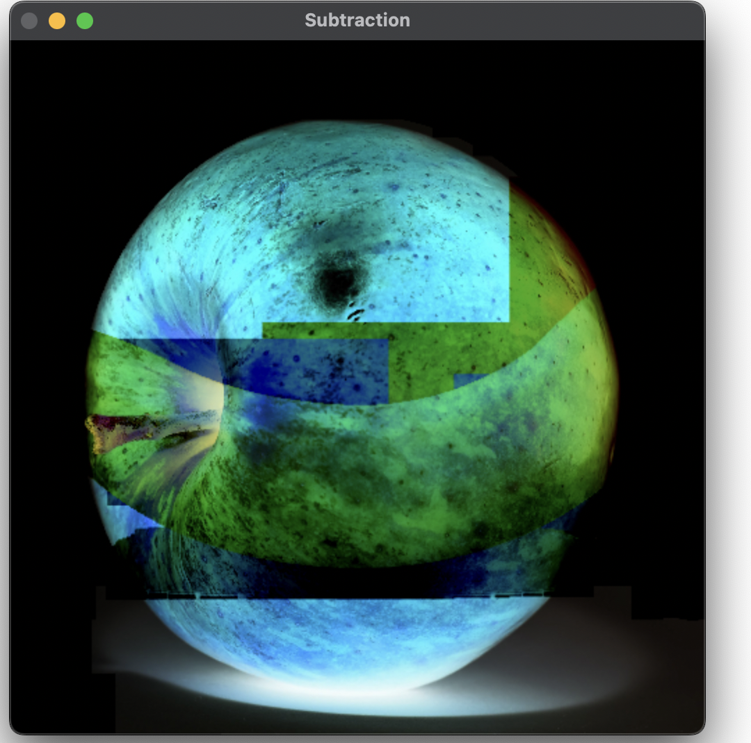
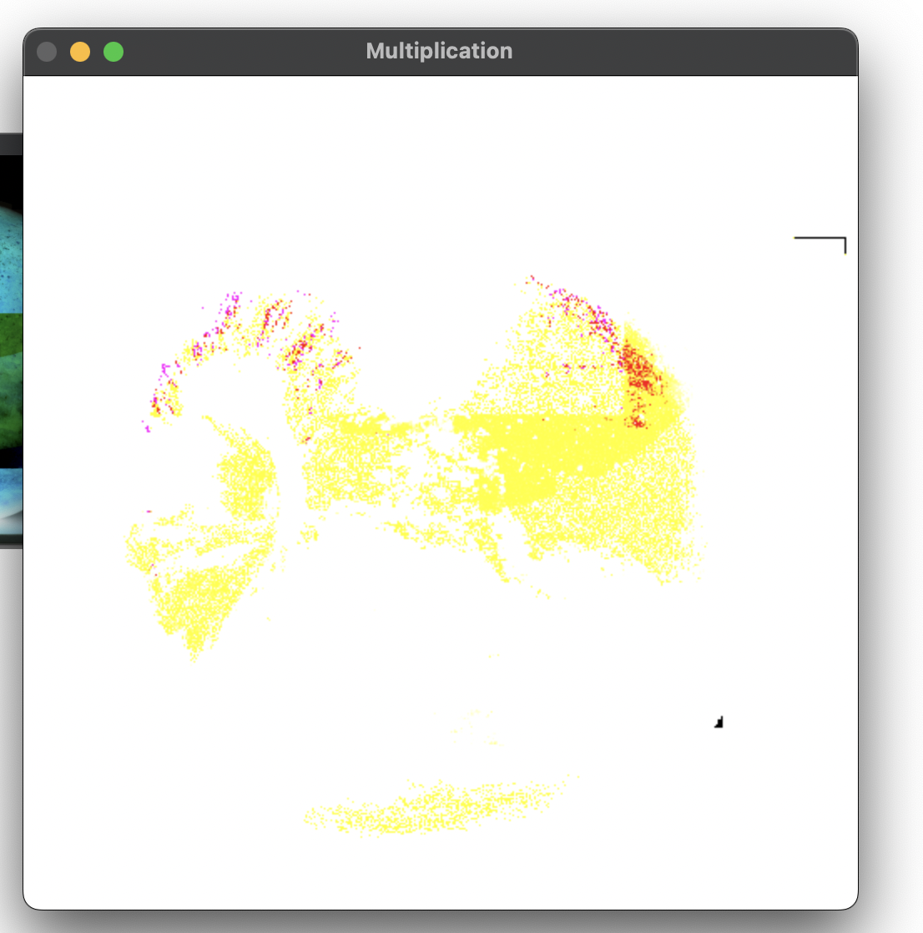
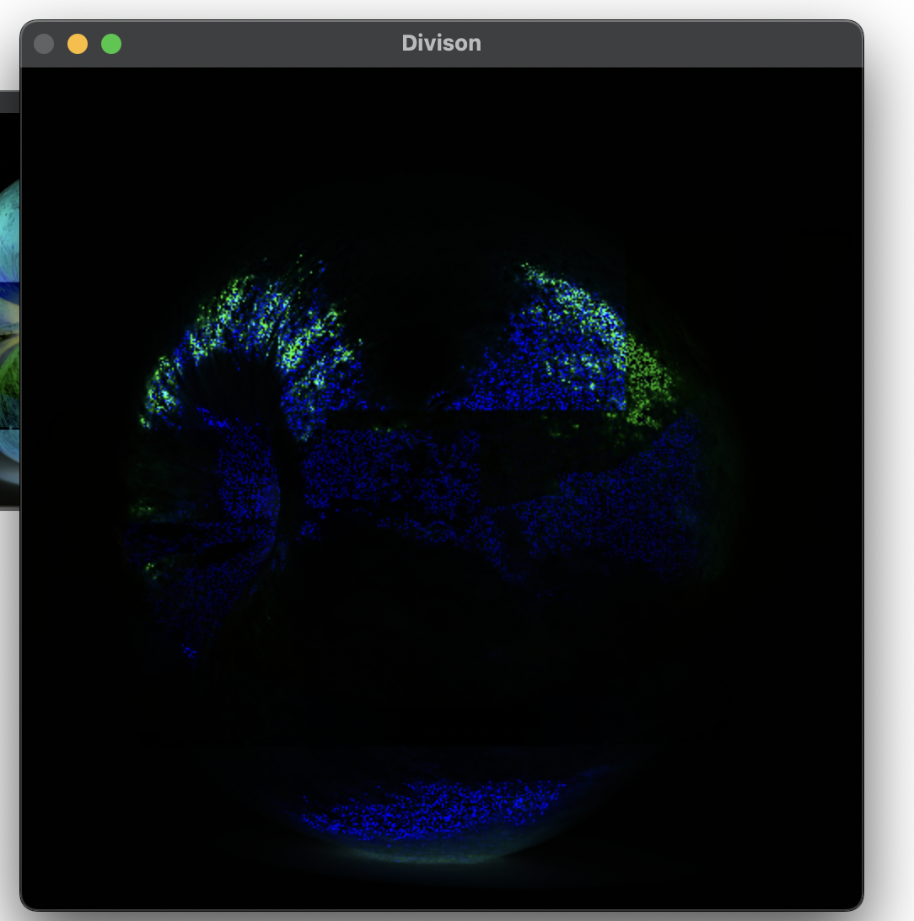
OUTPUT-:(OPENCV)

Slide 11
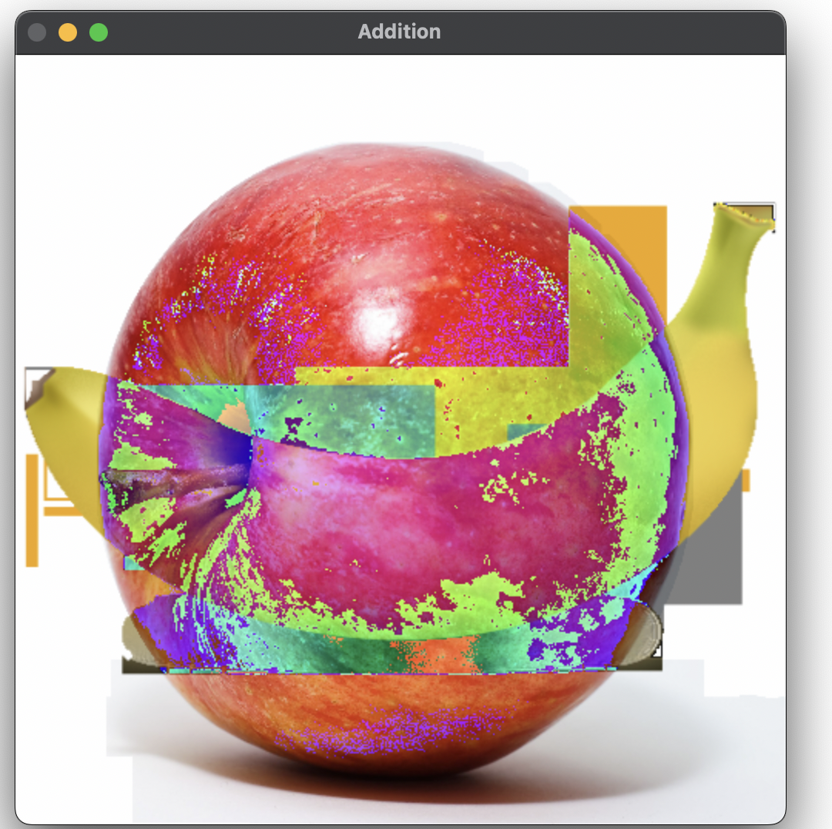
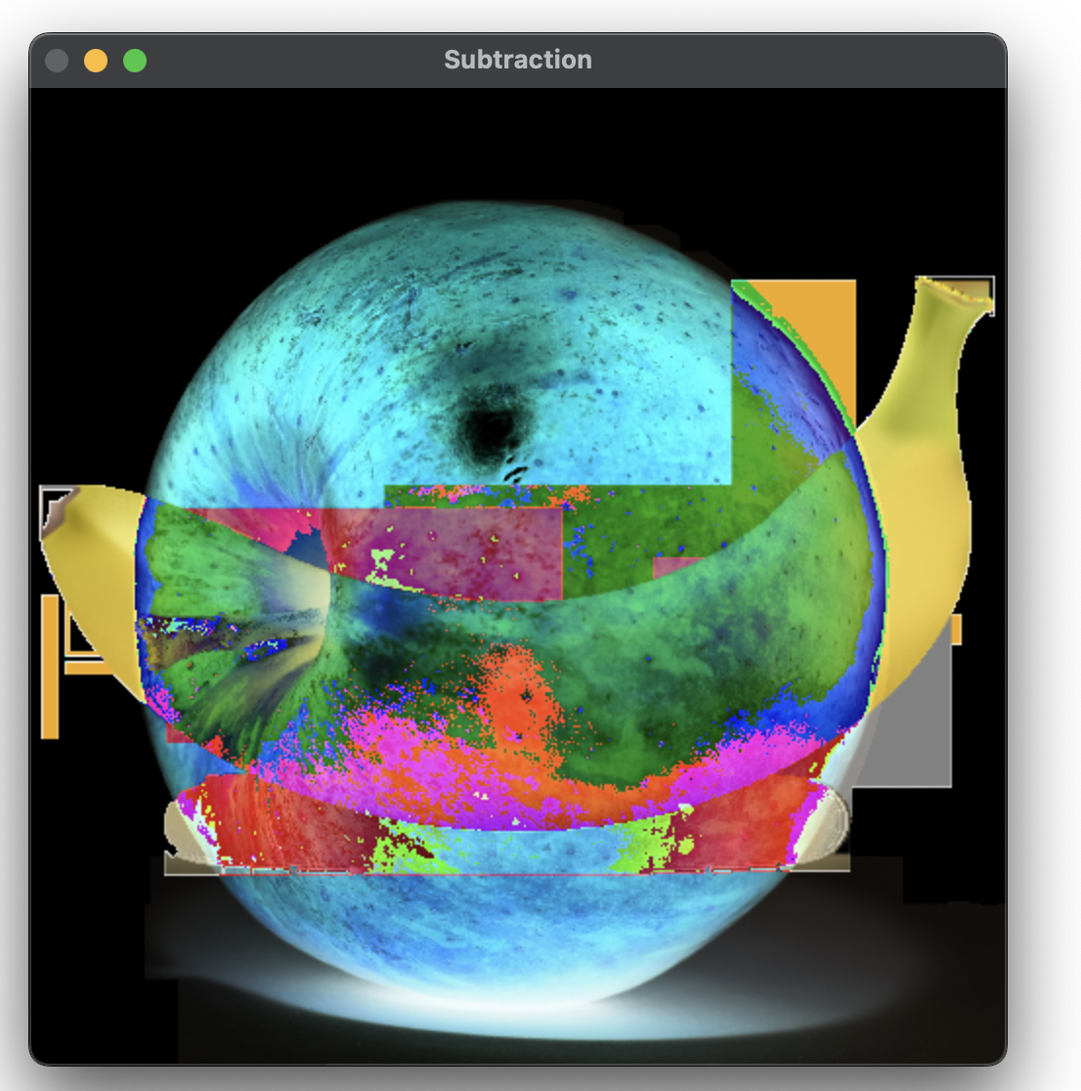
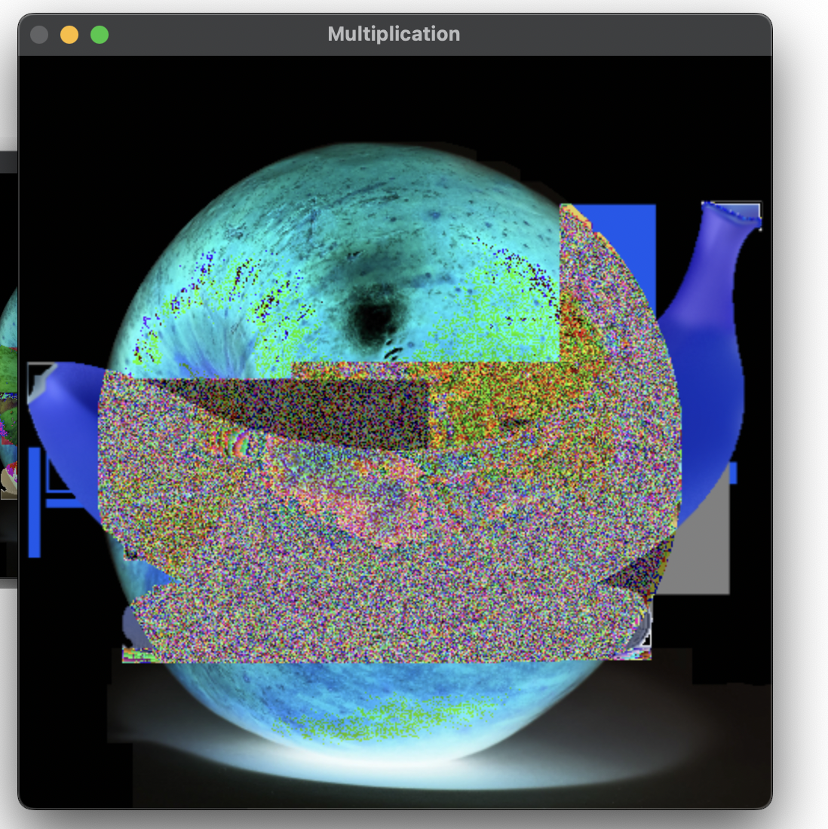
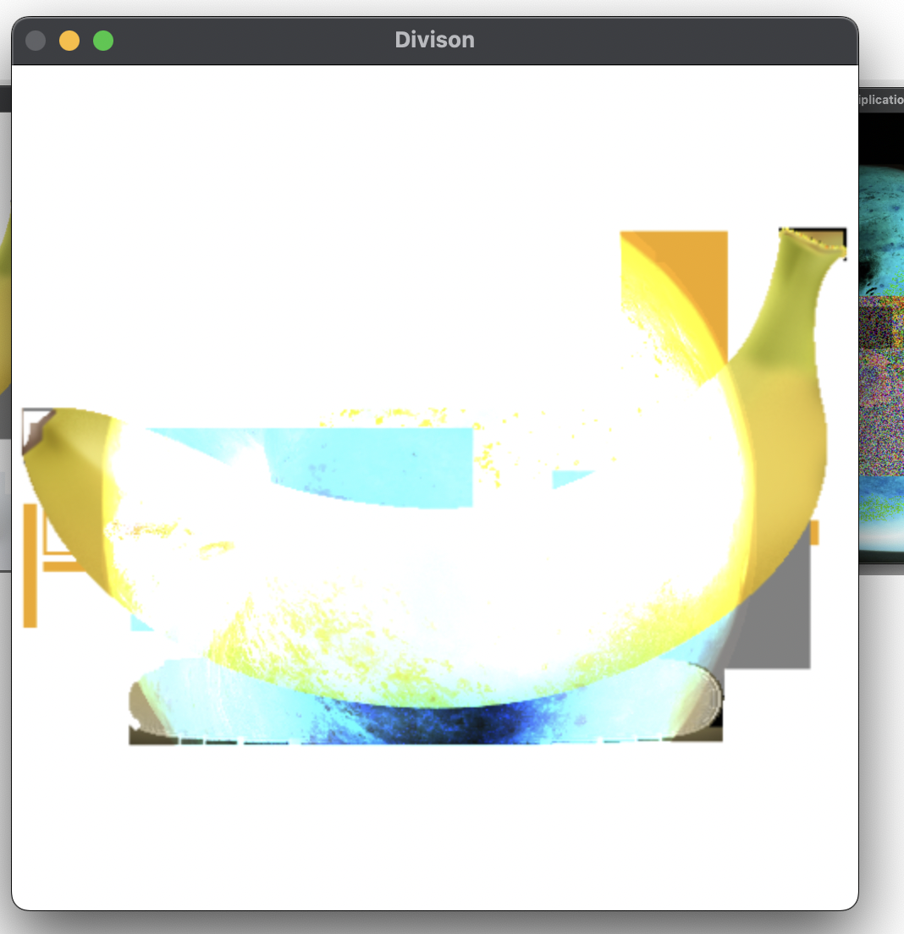
OUTPUT-:(NUMPY)

Slide 12
THANK YOU
You can find the code at -:
https://github.com/Baka-14/Digital_Image_processing

